Slide 2
Witnessing
(soul winning)
(sharing Jesus)
(evangelism)

Slide 3
“VIRTUAL Evangelism”

Slide 4
Why Aren’t
We Motivated?
Destroying APATHY: Session 1

Slide 5
SOME Christians ignore or misunderstand Jesus’ COMMANDS.

Slide 6
“Go ye therefore, and teach all nations, baptizing them in the name of the Father, and of the Son, and of the Holy Ghost:
Teaching them to observe all things whatsoever I have commanded you: and, lo, I am with you always, even unto the end of the world. Amen.”
Matthew 28:19-20 KJV

Slide 7
“Then said Jesus to them again, ‘Peace be unto you: as my Father hath sent me, even so send I you.’”
John 20:21 KJV

Slide 8
SOME believers are evangelists.

Slide 9
“And he gave some, apostles; and some, prophets; and some, evangelists; and some, pastors and teachers;”
Ephesians 4:11 KJV

Slide 10
All believers are witnesses.

Slide 11
“But ye shall receive power, after that the Holy Ghost is come upon you: and ye shall be witnesses unto me both in Jerusalem, and in all Judaea, and in Samaria, and unto the uttermost part of the earth.”
Acts 1:8 KJV

Slide 12
It is important to understand the why of witnessing!

Slide 13
“Now to him that is of power to stablish you according to my gospel, and the preaching of Jesus Christ, according to the revelation of the mystery, which was kept secret since the world began,
But now is made manifest, and by the scriptures of the prophets, according to the commandment of the everlasting God, made known to all nations for the obedience of faith: To God only wise, be glory through Jesus Christ for ever. Amen.”
Romans 16:25-27 KJV

Slide 14
God’s desire is that all people should worship Him through Jesus Christ.

Slide 15
“For all things are for your sakes, that the abundant grace might through the thanksgiving of many redound to the glory of God.”
2 Corinthians 4:15 KJV

Slide 16
Worship should lead to witnessing which will lead to more worshippers!

Slide 17
MANY Christians have misplaced PRIORITIES.

Slide 18
“And the cares of this world, and the deceitfulness of riches, and the lusts of other things entering in, choke the word, and it becometh unfruitful.”
Mark 4:19 KJV

Slide 19
the worries/cares of this world

Slide 20
the deceitfulness of riches

Slide 21
the lusts/desires of other things

Slide 22
MOST Christians forget about the fate of LOST people.

Slide 23
“There was a certain rich man, which was clothed in purple and fine linen, and fared sumptuously every day: And there was a certain beggar named Lazarus, which was laid at his gate, full of sores, And desiring to be fed with the crumbs which fell from the rich man's table: moreover the dogs came and licked his sores.”
Luke 16:19-21 KJV

Slide 24
“And it came to pass, that the beggar died, and was carried by the angels into Abraham's bosom: the rich man also died, and was buried;”
Luke 16:22 KJV

Slide 25
Everyone is going to die.

Slide 26
“And in hell he lift up his eyes, being in torments, and seeth Abraham afar off, and Lazarus in his bosom. And he cried and said, Father Abraham, have mercy on me, and send Lazarus, that he may dip the tip of his finger in water, and cool my tongue; for I am tormented in this flame.”
Luke 16:23-24 KJV

Slide 27
Hell is real.

Slide 28
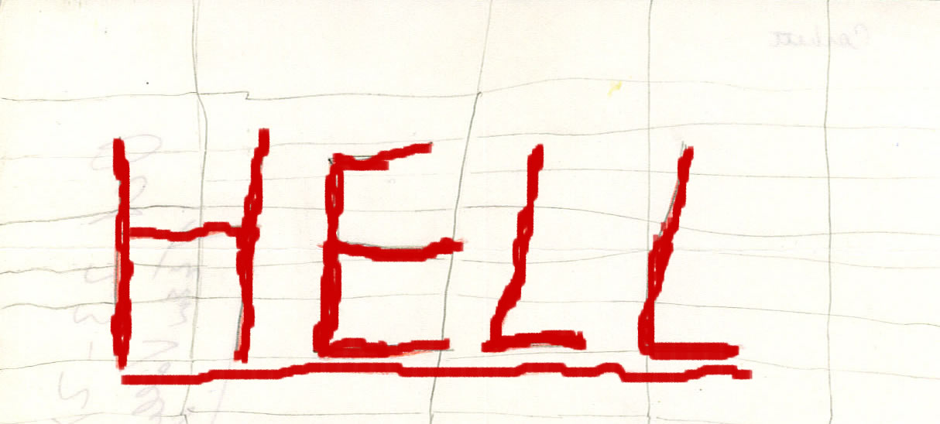

Slide 29
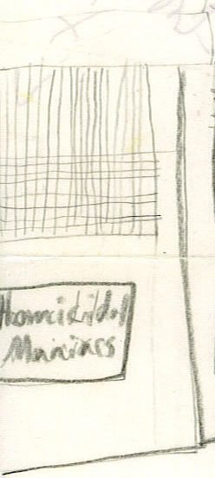

Slide 31
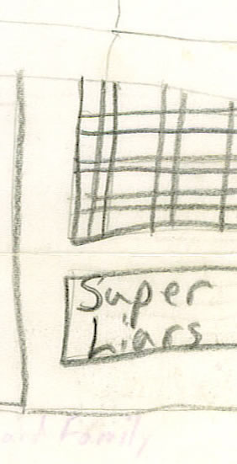

Slide 32
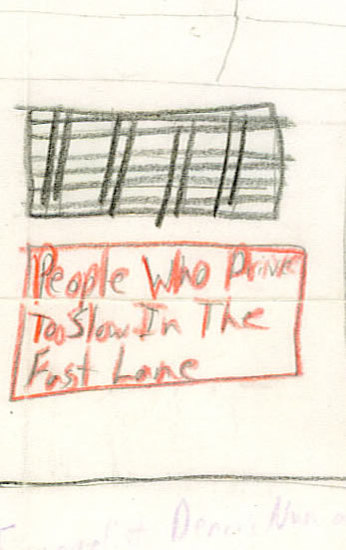

Slide 33
“And in hell he lift up his eyes, being in torments, and seeth Abraham afar off, and Lazarus in his bosom. And he cried and said, Father Abraham, have mercy on me, and send Lazarus, that he may dip the tip of his finger in water, and cool my tongue; for I am tormented in this flame.”
Luke 16:23-24KJV

Slide 34
“And in hell he lift up his eyes, being in torments, and seeth Abraham afar off, and Lazarus in his bosom. And he cried and said, Father Abraham, have mercy on me, and send Lazarus, that he may dip the tip of his finger in water, and cool my tongue; for I am tormented in this flame.”
Luke 16:23-24 KJV

Slide 35
“And in hell he lift up his eyes, being in torments, and seeth Abraham afar off, and Lazarus in his bosom. And he cried and said, Father Abraham, have mercy on me, and send Lazarus, that he may dip the tip of his finger in water, and cool my tongue; for I am tormented in this flame.”
Luke 16:23-24KJV

Slide 36
““And in hell he lift up his eyes, being in torments, and seeth Abraham afar off, and Lazarus in his bosom. And he cried and said, Father Abraham, have mercy on me, and send Lazarus, that he may dip the tip of his finger in water, and cool my tongue; for I am tormented in this flame.”
Luke 16:23-24 KJV

Slide 37
“But Abraham said, Son, remember that thou in thy lifetime receivedst thy good things, and likewise Lazarus evil things: but now he is comforted, and thou art tormented.”
Luke 16:25 KJV

Slide 38
“And beside all this, between us and you there is a great gulf fixed: so that they which would pass from hence to you cannot; neither can they pass to us, that would come from thence.”
Luke 16:26 KJV

Slide 39
There is no second chance.

Slide 40
“Then he said, I pray thee therefore, father, that thou wouldest send him to my father's house: For I have five brethren; that he may testify unto them, lest they also come into this place of torment. Abraham saith unto him, They have Moses and the prophets; let them hear them.”
Luke 16:27-29 KJV

Slide 41
“‘And he said, Nay, father Abraham: but if one went unto them from the dead, they will repent. And he said unto him, If they hear not Moses and the prophets, neither will they be persuaded, though one rose from the dead.’”
Luke 16:30-31 KJV

Slide 42
God uses the Gospel, not miracles, to save people.

Slide 43
What now?

Slide 44
What now?
Based on what we have just seen in God’s Word, what should you do today?

Slide 45
“But be ye doers of the word, and not hearers only, deceiving your own selves.”
James 1:22 KJV

Slide 46
Decide to OBEY the Lord.

Slide 47
“I have glorified thee on the earth: I have finished the work which thou gavest me to do.”
Jesus in John 17:4 KJV

Slide 48
Decide to OBEY the Lord.
Ask God to give you a BURDEN.

Slide 49
Remember – you cannot be neutral in witnessing!

Slide 50
“He that is not with me is against me; and he that gathereth not with me scattereth abroad.”
Jesus in Matthew 12:30 KJV

Slide 52
What Do We Say?
Developing KNOW HOW: Session 2

Slide 53
“But ye shall receive power, after that the Holy Ghost is come upon you: and ye shall be witnesses unto me both in Jerusalem, and in all Judaea, and in Samaria, and unto the uttermost part of the earth.”
Acts 1:8 KJV

Slide 54
A model for witnessing – Paul in Acts 26:1-23

Slide 55
A model for witnessing – Paul in Acts 26:1-23
A. His life BEFORE he knew Jesus, v. 1-11

Slide 56
A model for witnessing – Paul in Acts 26:1-23
A. His life BEFORE he knew Jesus, v. 1-11
B. HOW he met Jesus (when, where, who, what), v. 12-18

Slide 57
A model for witnessing – Paul in Acts 26:1-23
A. His life BEFORE he knew Jesus, v. 1-11
B. HOW he met Jesus (when, where, who, what), v. 12-18
C. His life SINCE Jesus came in, v. 19-23

Slide 58
Most Christians think,
“I don’t have a dramatic story like that – I don’t have much of a testimony.”

Slide 59
Most Christians think,
“I don’t have a dramatic story like that – I don’t have much of a testimony.”

Slide 60
Remember, before you accepted Jesus you were:

Slide 61
LOST
Developing KNOW HOW: Session 2

Slide 62
LOST
“For the Son of man is come to seek and to save that which was lost.”
Luke 19:10 KJV

Slide 63
BLIND
Developing KNOW HOW: Session 2

Slide 64
BLIND
“In whom the god of this world hath blinded the minds of them which believe not, lest the light of the glorious gospel of Christ, who is the image of God, should shine unto them.”
2 Corinthians 4:4 KJV

Slide 65
UNGODLY
Developing KNOW HOW: Session 2

Slide 66
UNGODLY
“But to him that worketh not, but believeth on him that justifieth the ungodly, his faith is counted for righteousness.”
Romans 4:5 KJV

Slide 67
DEAD
Developing KNOW HOW: Session 2

Slide 68
DEAD
“And you hath he quickened, who were dead in trespasses and sins;”
Ephesians 2:1 KJV

Slide 69
AN ENEMY OF GOD
Developing KNOW HOW: Session 2

Slide 70
AN ENEMY OF GOD
“…when we were enemies, we were reconciled to God by the death of his Son, much more, being reconciled, we shall be saved by his life.”
Romans 5:10 KJV

Slide 71
Do YOU have a testimony?

Slide 72
Do YOU have a testimony?
If you truly are a Christian–

Slide 73
Do YOU have a testimony?
If you truly are a Christian–

Slide 75
What Do We Say?
(Part 2)
Developing KNOW-HOW: Session 3

Slide 76
Do YOU have a testimony?

Slide 77
Do YOU have a testimony?
If you truly are a Christian–

Slide 78
Do YOU have a testimony?
If you truly are a Christian–

Slide 79
YOUR PERSONAL STORY

Slide 80
YOUR PERSONAL STORY
My life BEFORE I met Jesus.

Slide 81
YOUR PERSONAL STORY
My life BEFORE I met Jesus.

Slide 82
YOUR PERSONAL STORY
My life BEFORE I met Jesus.
HOW I came to accept Jesus into my life.

Slide 83
“…Jesus answered and said unto him, ‘Verily, verily, I say unto thee, Except a man be born again, he cannot see the kingdom of God.’”
John 3:3 KJV

Slide 84
“Moreover, brethren, I declare unto you the gospel…how that Christ died for our sins according to the scriptures;
And that he was buried, and that he rose again the third day according to the scriptures:”
1 Corinthians 15:1, 3-4 KJV

Slide 85
“For I am not ashamed of the gospel of Christ: for it is the power of God unto salvation to every one that believeth...”
Romans 1:16 KJV

Slide 86
YOUR PERSONAL STORY
My life BEFORE I met Jesus.
HOW I came to accept Jesus into my life.

Slide 87
YOUR PERSONAL STORY
My life BEFORE I met Jesus.
HOW I came to accept Jesus into my life.
My life SINCE Jesus came in.

Slide 88
What was the 1st immediate life change?
Then back to secular.
Share the most challenging or painful experience since you were saved.

Slide 89
“Having therefore obtained help of God, I continue unto this day, witnessing both to small and great…”
Acts 26:22 KJV

Slide 90
YOUR PERSONAL STORY
My life BEFORE I met Jesus.
HOW I came to accept Jesus into my life.
My life SINCE Jesus came in.

Slide 91
What now?

Slide 92
What now?
Based on what we have just seen in God’s Word, what should you do today?

Slide 93
“But be ye doers of the word, and not hearers only, deceiving your own selves.”
James 1:22 KJV

Slide 94
Make a commitment to share your story WITH TWO PEOPLE before next Sunday.

Slide 96
Why Are We Afraid?
Defeating FEAR: Session 4

Slide 97
Phobia (fō’-bē- ) n. A persistent, abnormal or illogical fear of a specific thing or situation
e

Slide 98
Ophidiophobia

Slide 99
Ophidiophobia
Cacophobia

Slide 100
Ophidiophobia
Cacophobia
Aviophobia

Slide 101
Phalacrophobia

Slide 102
Phalacrophobia
Pentheraphobia

Slide 103
Phalacrophobia
Pentheraphobia
Glossophobia

Slide 104
Phalacrophobia
Pentheraphobia
Glossophobia
Sesquipedalophobia

Slide 105
Witnessophobia!

Slide 106
How to Overcome Your
FEAR of Witnessing

Slide 107
Understand that FEAR is normal.

Slide 108
“And I, brethren, when I came to you, came not with excellency of speech or of wisdom, declaring unto you the testimony of God. For I determined not to know any thing among you, save Jesus Christ, and him crucified. And I was with you in weakness, and in fear, and in much trembling.”
1 Corinthians 2:1-3 KJV

Slide 109
“For, when we were come into Macedonia, our flesh had no rest, but we were troubled on every side; without were fightings, within were fears.”
2 Corinthians 7:5 KJV

Slide 110
Ask FRIENDS to pray for you.

Slide 111
“And for me, that utterance may be given unto me, that I may open my mouth boldly, to make known the mystery of the gospel, for which I am an ambassador in bonds: that therein I may speak boldly, as I ought to speak .”
Ephesians 6:19-20 KJV

Slide 112
Expect to FACE opposition.

Slide 113
“Remember the word that I said unto you, The servant is not greater than his lord. If they have persecuted me, they will also persecute you; if they have kept my saying, they will keep yours also.
John 15:20 KJV

Slide 114
FOCUS on your rewards.

Slide 115
FOCUS on your rewards.
ETERNAL

Slide 116
“Now he that planteth and he that watereth are one: and every man shall receive his own reward according to his own labour.”
1 Corinthians 3:8 KJV

Slide 117
FOCUS on your rewards.
EARTHLY

Slide 118
“That the communication of thy faith may become effectual by the acknowledging of every good thing which is in you in Christ Jesus.”
Philemon 1:6 KJV

Slide 119
FORSAKE the “win-them” mentality.

Slide 120
“Who then is Paul, and who is Apollos, but ministers by whom ye believed, even as the Lord gave to every man? I have planted, Apollos watered; but God gave the increase. So then neither is he that planteth any thing, neither he that watereth; but God that giveth the increase.”
1 Corinthians 3:5-7 KJV

Slide 121
Don’t FORGET that you have good news.

Slide 122
Don’t FORGET that you have good news.
“Gospel” = Good News

Slide 123
Don’t FORGET that you have good news.
“Gospel” = Good News
Luke 2:8-11

Slide 124
FINALLY, remember that it is an obedience issue.

Slide 125
“For the Son of man came to seek and to save what was lost.”
Luke 19:10 KJV

Slide 126
“Then said Jesus to them again, ‘Peace be unto you: as my Father hath sent me, even so send I you.’”
John 20:21 KJV

Slide 127
What now?

Slide 128
What now?
Based on what we have just seen in God’s Word, what should you do today?

Slide 129
Make the DECISION to defeat your fears.

Slide 130
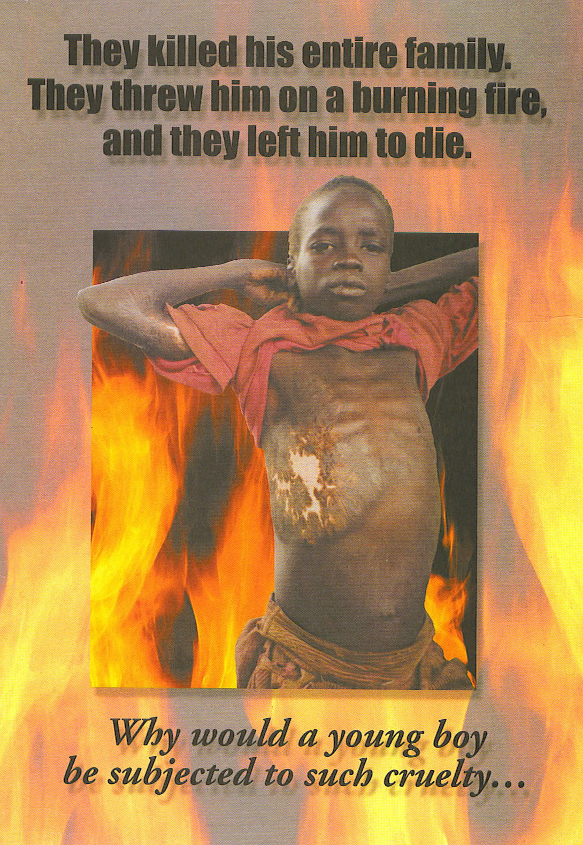

Slide 131
“For God hath not given us the spirit of fear; but of power, and of love, and of a sound mind. Be not thou therefore ashamed of the testimony of our Lord…”
2 Timothy 1:7-8 KJV

Slide 132
Knowing it is God’s will, and with God’s help, starting RIGHT NOW I will not let fear keep me from witnessing.

Slide 134
What Do We Say?
(Part 3)
Developing KNOW-HOW: Session 5

Slide 135
HONING YOUR PERSONAL STORY

Slide 136
My life before I met Jesus.

Slide 137
My life before I met Jesus.

Slide 138
My life before I met Jesus.
How I came to accept Jesus into my life.

Slide 139
“Moreover, brethren, I declare unto you the gospel … For I delivered unto you first of all that which I also received, how that Christ died for our sins according to the scriptures ; And that he was buried, and that he rose again the third day according to the scriptures:”
1 Corinthians 15:1, 3-4 KJV

Slide 140
“For I am not ashamed of the gospel of Christ: for it is the power of God unto salvation to every one that believeth…”
Romans 1:16 KJV

Slide 141
My life before I met Jesus.
How I came to accept Jesus into my life.

Slide 142
My life before I met Jesus.
How I came to accept Jesus into my life.
My life since Jesus came in.

Slide 143
My life before I met Jesus.
How I came to accept Jesus into my life.
My life since Jesus came in.

Slide 145
Listen for people sharing EXPERIENCES like yours.

Slide 146
Listen for people sharing EXPERIENCES like yours.
Listen for people sharing EMOTIONS like yours.

Slide 147
Listen/look for opportunities in current EVENTS.

Slide 148
Listen/look for opportunities in current EVENTS.
Make LEADING statements.

Slide 150
It is different sharing your testimony in ONE TIME meetings than with regular friends and acquaintances.

Slide 151
2. Expect MIXED results.
“And when they heard of the resurrection of the dead, some mocked: and others said, We will hear thee again of this matter….However certain men clave unto him, and believed…”
Acts 17:32-34 KJV

Slide 152
Remember inviting people to church is good, but it is not GOING.

Slide 153
“Go ye therefore, and teach all nations, baptizing them in the name of the Father, and of the Son, and of the Holy Ghost:”
Matthew 28:19 KJV

Slide 155
What Do We Say?
(Part 4)
Developing KNOW-HOW: Session 6

Slide 156
You can witness with your thanksgiving.

Slide 157
“For every creature of God is good, and nothing to be refused, if it be received with thanksgiving…”
1 Timothy 4:4 KJV

Slide 158
Pray if you are alone.

Slide 159
Ask to pray for your server.

Slide 160
“(Name), we always give thanks for our food. Is there anything going on in your life – family, friends, health – that we can pray about for you?”

Slide 161
Ask to pray for the others at your table.

Slide 162
“I always give thanks for my food. If you like, I’ll just pray for both (all) of us.”

Slide 163
“Father, thank you for this food. Thank you for loving us. In Jesus’ name, Amen.”

Slide 165
You can witness with your tracts.

Slide 166
“I am made all things to all men, that I might by all means save some.”
1 Corinthians 9:22 KJV

Slide 167
The “Shotgun” approach

Slide 168
Use your personal favorite

Slide 169
The “Rifle” approach

Slide 170
What now?

Slide 171
What now?
Based on what we have just seen in God’s Word, what should you do today?

Slide 172
I will pray at EVERY MEAL this week, by myself – or for my server – or for others at the table.

Slide 173
I will give at least ONE TRACT away this week.

Slide 174
I will share my personal testimony with at least ONE PERSON this week.

Slide 176
How Can We See Results?
Appropriating DIVINE POWER: Session 7

Slide 177
“…But ye shall receive power, after that the Holy Ghost is come upon you: and ye shall be witnesses unto me…”
Acts 1:8 KJV

Slide 178
The power of the Holy Spirit results in a life that is a witness.

Slide 179
“But the fruit of the Spirit is love, joy, peace, longsuffering, gentleness, goodness, faith, meekness, temperance…”
Galatians 5:22-23 KJV

Slide 180
Love

Slide 181
Love
Joy

Slide 182
Love
Joy
Peace

Slide 183
Love
Joy
Peace
Longsuffering

Slide 184
Love
Joy
Peace
Longsuffering
Gentleness

Slide 185
Love
Joy
Peace
Longsuffering
Gentleness
Goodness

Slide 186
Love
Joy
Peace
Patience
Kindness
Goodness
Faith

Slide 187
Love
Joy
Peace
Patience
Kindness
Goodness
Faith
Meekness

Slide 188
Love
Joy
Peace
Patience
Kindness
Goodness
Faith
Meekness
Temperance

Slide 189
“The Holy Spirit is the one who makes real in you what Christ has done for you.”
Oswald Chambers

Slide 190
Notice again Acts 1:8
“But ye shall receive power, after that the Holy Ghost is come UPON you..”

Slide 191
Notice again Acts 1:8
“…But ye shall receive power, after that the Holy Ghost is come UPON you and ye shall be witnesses….”

Slide 192
The disciples had the Holy Spirit in them.

Slide 193
The disciples had the Holy Spirit in them.
“And when he had said this, he breathed on them, and saith unto them, Receive ye the Holy Ghost:”
John 20:22 KJV

Slide 194
But they needed an empowering by the Holy Spirit and they received it on the Day of Pentecost.

Slide 195
“And they were all filled with the Holy Ghost…Praising God, and having favour with all the people. And the Lord added to the church daily such as should be saved.”
Acts 2:4, 47 KJV

Slide 196
“And they were all filled with the Holy Ghost…Praising God, and the Lord added to the church daily such as should be saved.”
Acts 2:4, 47 KJV

Slide 197
“And they were all filled with the Holy Ghost, and they spoke the word of God with boldness.”
Acts 4:31 KJV

Slide 198
“And they were all filled with the Holy Ghost, and they spoke the word of God with boldness.”
Acts 4:31 KJV

Slide 199
How does the Holy Spirit come ON you?

Slide 200
How does the Holy Spirit come ON you?

Slide 201
Like the early disciples, if you are truly a Christian, you have the Holy Spirit in you. He came in when you were saved.

Slide 202
But also like the first disciples, you need to be empowered to be filled with the Holy Spirit.

Slide 203
But also like the first disciples, you need to be empowered to be filled with the Holy Spirit.

Slide 204
In fact, we are commanded to be filled with the Holy Spirit:

Slide 205
“…understanding what the will of the Lord is…be filled with the Spirit…”
Ephesians 5:17-18 KJV

Slide 206
SO THE QUESTION IS:

Slide 207
SO THE QUESTION IS:
How are you to be “filled with the Spirit?”

Slide 208
If something is to be filled with any substance, it must be EMPTIED of anything that is already in it!

Slide 209
How can YOU be filled with the Holy Spirit?

Slide 210
Empty yourself of anything and everything that does not please God.

Slide 211
“If we confess our sins, he is faithful and just to forgive us our sins, and to cleanse us from all unrighteousness.”
1 John 1:9 KJV

Slide 212
Of every DEED/ACTION

Slide 213
Of every DEED/ACTION
Of every WORD

Slide 214
Of every DEED/ACTION
Of every WORD
Of every THOUGHT

Slide 215
Ask Him to fill you right now with His Holy Spirit!

Slide 216
What Now?

